Slide 1
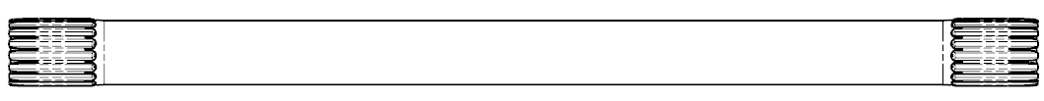
CCM-87: Short T-bar No Profile Grind (Gen 5)
Last updated: 01JA15
Description
No profile grind short t-bar, shallower holes, shorter stop tooth travel, increased hardness, larger press interference range, higher press load tolerance & lower hysteresis
Motivation : 7.0
Deliverables
Lower hysteresis and cost
Press & fatigue robustness
MQ, PV Build success
Capable to +/- 1° stop tooth balance
Timing
Now, Fiasa and BMPV
Team Members/Customers
Team names: Dan Diffin
Customers: Applications Teams
Gen 3
Gen 5

Slide 2
CCM-87: Short T-bar No Profile Grind (Gen 5)
Last updated: 08JN15
Status Update:
$0.39 savings over Gen 3
Hysteresis below 0.2Nm
Robust to press & short stop tooth fatigue
Can not open up short stop tooth travel due to fatigue sensitivity due to spline root sub the active section dia.
Many changes to the rolling machine and process parameters has improved serration OD size and roundness but did not improve balance
Challenges:
Stop tooth balance capability
Latest bars made for Faisa MQ2 (263 asms)
Need to be capable to +/-1°
+/- 1° ppk: 0.58
+/- 2° ppk: 1.10
Min torque before stop tooth contact below 8Nm requirement
Next Actions:
250 part trial for BMPV
Alternative/extra processes
End feed rolling: Promising results but no production machine available
Coining to form end of serration post rolling

